Slide 1
Glucose Data Processing and Visualisation
Dr Zhiqiang Zhang
School of Electronic and Electrical Engineering
School of Mechanical Engineering
Faculty of Engineering and Physical Sciences
Email: z.zhang3@leeds.ac.uk
Room: EEE 1.69

Slide 2
Aims
Given the glucose data set ( 3 files),
Design a filter in Matlab/python to remove the high frequency noise
Display the de-noised data and discuss the performance of the filter
Develop/apply peak detection routines to automatically detect the high/low peaks in glucose

Slide 3
Analyse what is the physiological relevance of these peaks and discuss what are the ethical implications of a breach of CGM data. For example, you can discuss what information about the lifestyle of the subject you can extract from the data (i.e when does the subject goes to sleep, when does he/she eat breakfast, does he/she exercise regularly? Any lift style difference between 2022, 2023 and 2024 .. You may want to use the time information as well)
Submit a three-pages presentation ( together with the research project presentation)

Slide 4
Software requirement
Matlab https://uk.mathworks.com/academia/tah-portal/university-of-leeds-40586183.html
Online Matlab: https://matlab.mathworks.com/ and https://drive.matlab.com/
It is OK to use other languages/platforms, i.e., python, maple etc.

Slide 5
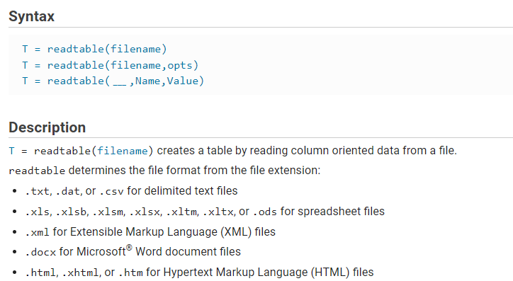
Load the data to Matlab
https://uk.mathworks.com/help/matlab/ref/readtable.html

Slide 6
Other function you can use
https://uk.mathworks.com/help/matlab/ref/csvread.html
csvread("glucose_2024.csv",1,4,[1,4,1098,4]);
https://uk.mathworks.com/help/matlab/ref/readmatrix.html
M = readmatrix('glucose_2024.csv','Range’,’E2:E11')

Slide 7
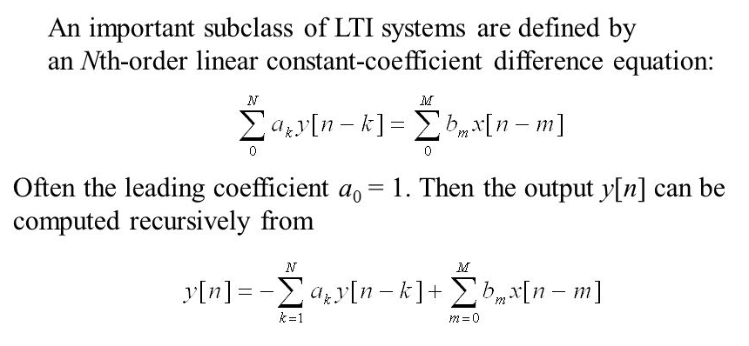
Filtering

Slide 8
Matlab filtering
https://uk.mathworks.com/help/signal/ref/butter.html
https://uk.mathworks.com/help/matlab/ref/filter.html

Slide 9
Filtering: frequency
Fast Fourier Transformations
a signal can be considered as a summation of sine waves with different frequency velocity
The FFT algorithm can be described as a decomposition of the EMG signal to its underlying sinus contents

Slide 10
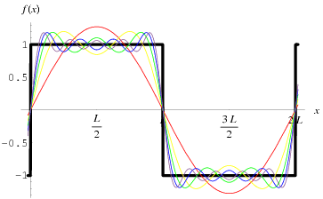


Slide 11
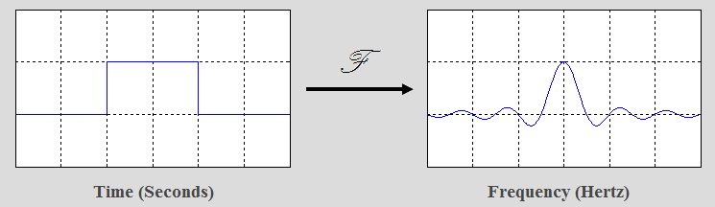
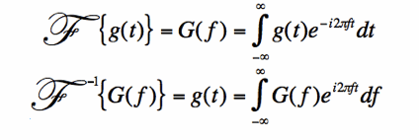
Fourier Series to Fourier Transform

Slide 12
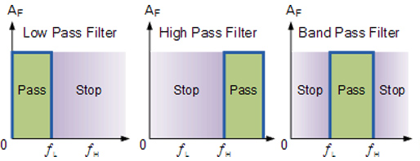
Signal processing: filtering
Low pass filtering
High pass filtering
Band pass filtering

Slide 13
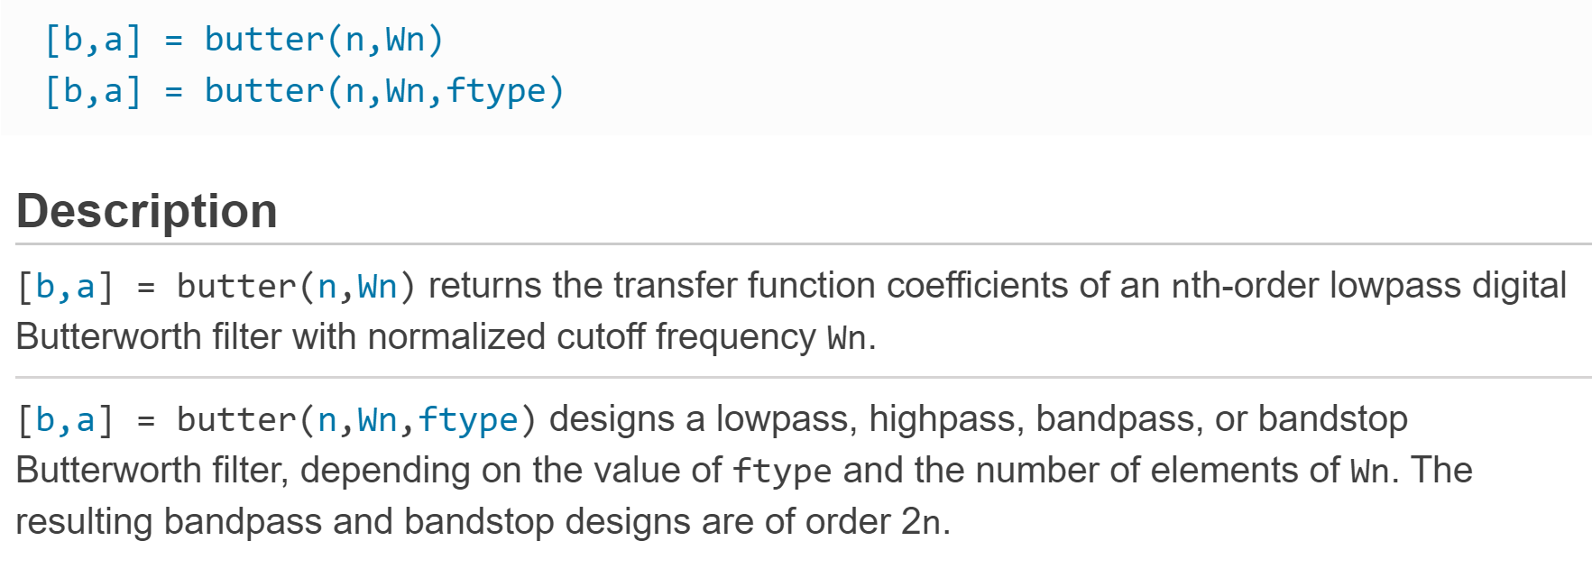
Filter design

Slide 14
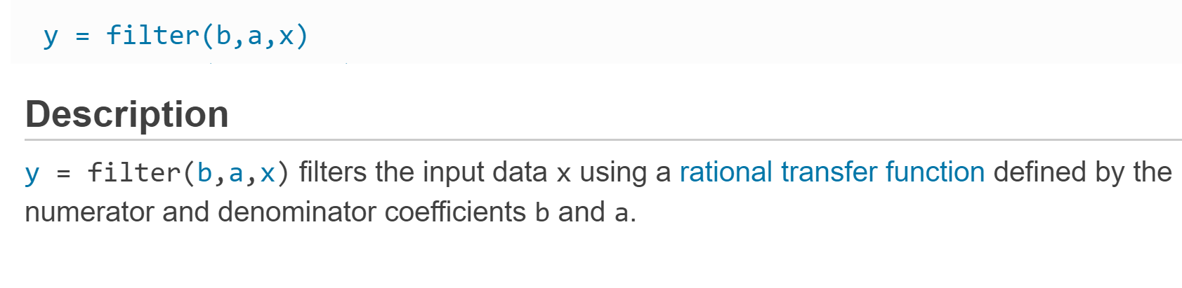
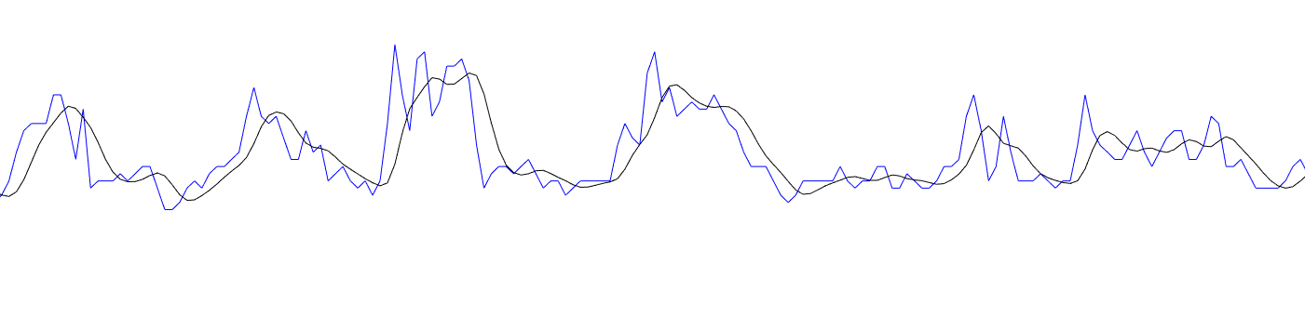
Filter design

Slide 15
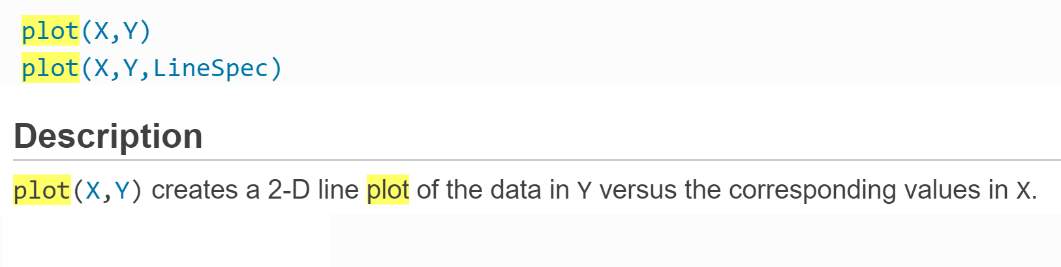
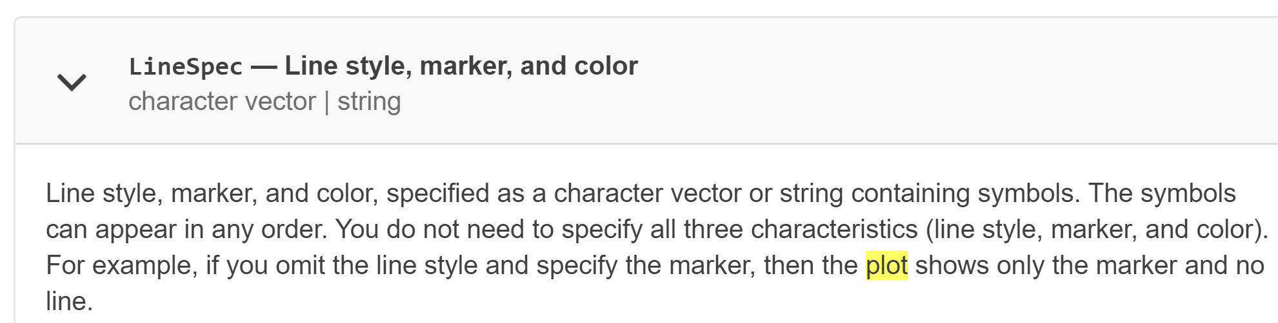
Visualise the data
https://uk.mathworks.com/help/matlab/creating_plots/using-high-level-plotting-functions.html

Slide 16
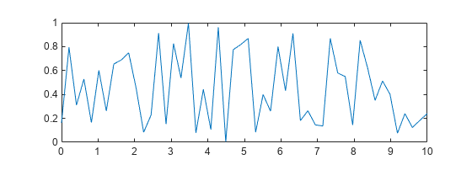
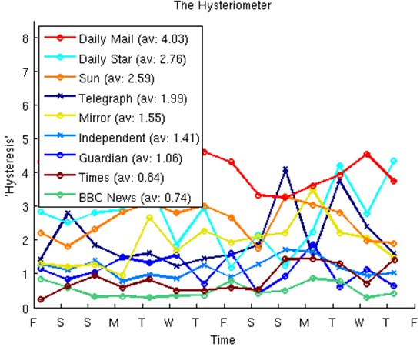

Slide 17
Peak detection
https://uk.mathworks.com/matlabcentral/fileexchange/47264-peakdet
https://www.mathworks.com/help/signal/ref/findpeaks.html

Slide 18
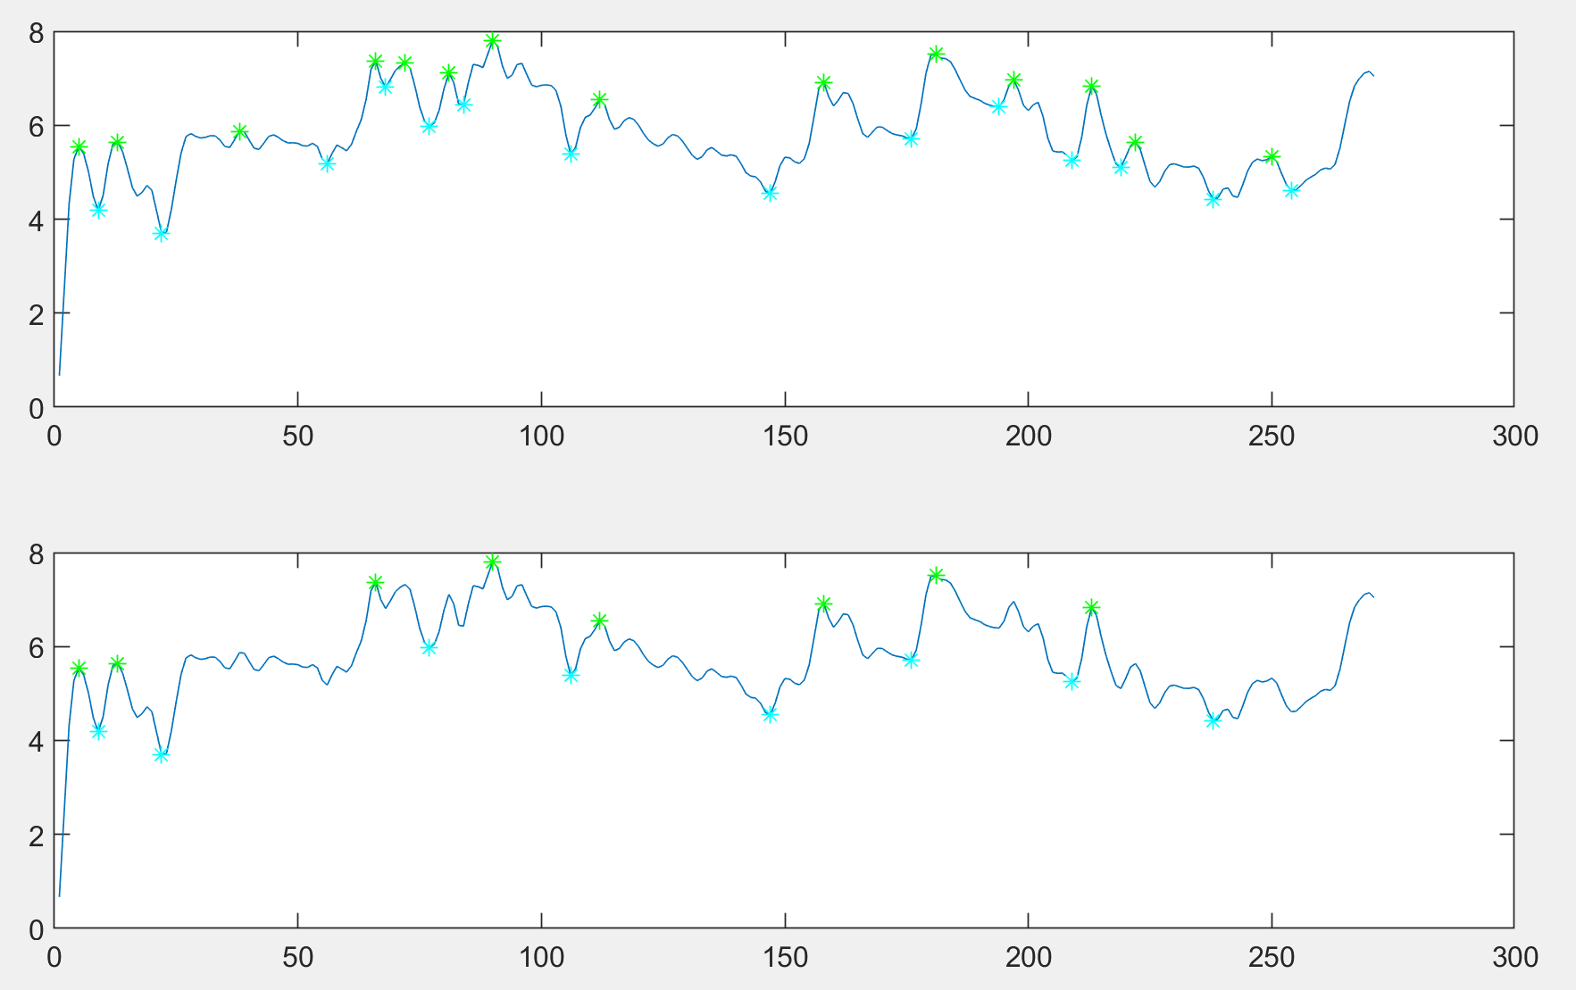
Peak detection

